Slide 1

UDP
UDP Packets
UDP in Python
Responding to a Request
Using Pickles
Notes:
In this lesson we are going to send some messages between Python programs using UDP.
We’ll start with the basic parts of a UDP message and how they are laid out in the actual network packet.
Then we’ll look at the Python code.
We’ll see a server/client example where a server responds to a client’s request.
And finally we’ll look at Python PICKLES – which is a way of writing plain old Python objects to binary data and reading them back again. This is a great way to send objects, say, in a UDP packet.

Slide 2

See Also
https://wiki.python.org/moin/UdpCommunication
https://docs.python.org/3/library/pickle.html
Notes:
Here is some additional reading for you on the web.

Slide 3


UDP Packet
Source Address: 192.1.1.75
Source Port: 10445
Dest Address: 10.2.14.7
Dest Port: 4567
Data: “HELLO\x0A\x0D”
Source Address is the sender machine’s IP address
Source Port is the sender socket’s port number
Destination Address/Port is where the packet is going
Data is a Python string that usually contains binary data
How big can the string be?
Notes:
Here are the parts of a UDP packet.
@1 There is the source address – where the packet came from
@2 Remember, addresses have a port number too
These values are automatically written to the packet when you send it.
@3 There is the destination address and port. This is where the packet would like to go.
@4 And there is the data – the payload – the information being sent in the packet. In Python we represent this chunk of binary data with a regular old Python string.
@5 How big can the string be? In other words, how much data can you put in one UDP packet?
Let’s have a look at the binary format of the packet.

Slide 4
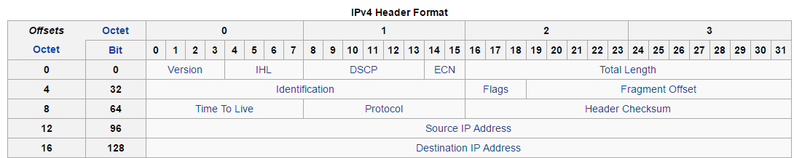
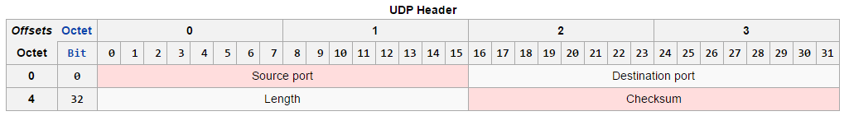
UDP Packet on the Wire
UDP Payload
65535 - 20 - 8 = 65507
MTU – Maximum Transmission Unit
Usually much less than 64K
Notes:
All packets sent over the internet protocol have a twenty byte header. You see the source ip address and the destination address here.
This byte describes the protocol after the header. The value for UDP is 17.
@1 This is the total length of the entire packet. Two bytes. That tells you the maximum size for any packet – be it UDP, TCP, whatever – is 65536. That’s 64K.
@2 After the IP header we have the 8 byte UDP header. This header has the port numbers – source and destination.
@3 And the two-byte length of the data.
@4 So … 65535 bytes max minus the 20 byte IP header and the 8 byte UDP header leaves a maximum length of the UDP payload of 65507.
HOWEVER
That’s a theoretical maximum. In reality, the size of a packet is restricted to much smaller. This keeps the size of individual packets down, which takes some strain off the operating system. And it keeps traffic flowing quickly on the network.
@5 This limit is called the M T U – the Maximum Transmission Unit.
@6 Most Ethernet networks use an MTU of 1500, which is much less than 64K.

Slide 5
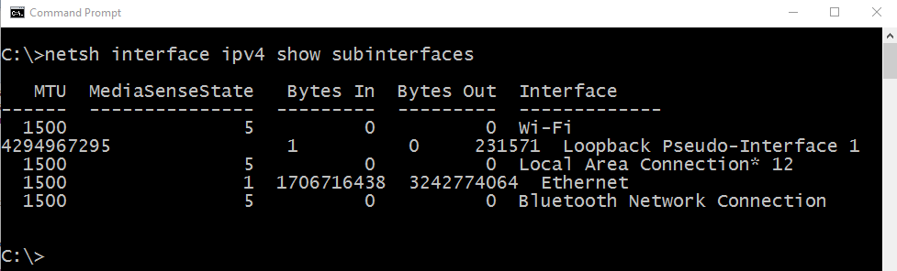
DatagramPacket
Notes:
You can find the MTU on your network with the NETSH command as shown here on my home computer.
The WIFI and the ETHERNET interfaces have the expected MTU of 1500. I must be using the Ethernet cable on my computer – look at the bytes in and out. I have used the wi-fi interface at all.

Slide 6
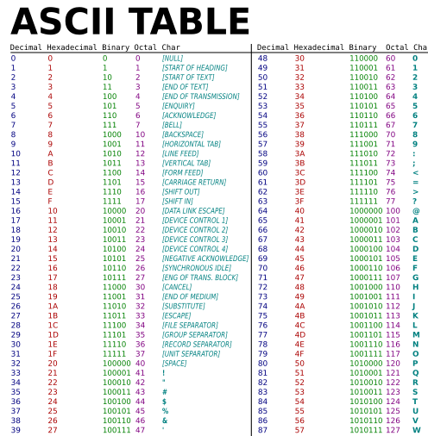
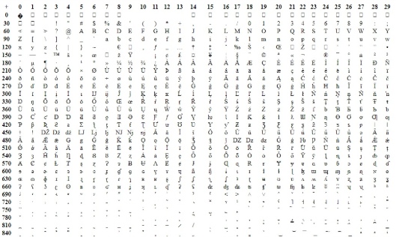
Bytes and Strings
>>> a = 'banos'
>>> a
'banos'
>>> a = '\x41\x42\x43'
>>> a
'ABC'
>>> b = b'banos'
>>> b
b'banos'
>>> b = b'\x44\x45\x46'
>>> b
b'DEF'
Notes:
Computers store everything as numbers – specifically every object is a series of bytes.
This goes for strings too. #1 we write text in our code between quotes. Those are characters. But under the covers, the computer converts those to numbers. #2 Generally a character is one byte – a value from the ASCII table everyone agreed on decades ago.
#3 Python allows you specify the hex codes directly, if you like. For instance, 41 42 and 43 are ASCII A,B, and C.
#4 Note that python will display readable characters instead of hex codes where it can.
In all our modern computer languages, input/output devices are modeled as streams of bytes. When you read from a file, you get a stream of bytes. When you write to a socket, you send a stream of bytes.
Python2 used these familiar strings as sequences of bytes. Your code read strings from files and wrote strings to sockets. It is simple and easy to understand, but you could run into problems when a character takes multiple bytes to represent.
A byte can hold 256 different values … 256 characters. Obviously, there are more characters than that. In fact there are hundreds of thousands. The countries got together and agreed on a single huge list of all the world’s characters in a single table – we call this numbering UNICODE.
Take this Spanish word ‘banos’. The ‘n’ should be written with a tilde over it. That’s a letter in Spanish that falls somewhere in this table. For characters like 450 and 720, we’ll need multiple bytes to represent a single letter.
We need to separate ‘characters’ from bytes. Python3 (like other languages) does just that. Python3 as a new type … bytes.
#6 It looks like a regular character string, except it has a ‘b’ up front outside the quotes.
#7 Python even prints it the same way … with human readable characters where possible.
#8 You can specify hex characters in byte strings too.
#9 In fact, the only difference in this example is the ‘b’ up front. The difference comes with multi-byte characters – I’ll show you that next.

Slide 7
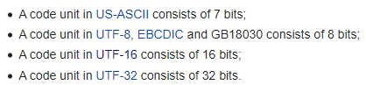
Character Encoding
https://en.wikipedia.org/wiki/Character_encoding
>>> len(b)
6
>>> len(a)
5
>>> c = a.encode('UTF-16')
>>> c
b'\xff\xfeb\x00a\x00\xf1\x00o\x00s\x00’
>>> len(c)
>>> 12
>>> b = b'ba\xC3\xB1os'
>>> b
b'ba\xc3\xb1os'
>>> a = b.decode( )
>>> a
'baños'
>>> a.encode( )
b'ba\xC3\xB1os'
'UTF-8'
Byte Order
Notes:
There are many ways to encode characters as bytes. We could just represent each letter with 4 bytes. Maybe two bytes will get us all the characters we need. For English strings, that’s a lot of wasted 0 bytes since most characters fit in one byte.
UTF-8 encoding uses one byte to represent each character where possible. For multi-byte characters, the upper most bit is set on multiple bytes that are grouped together. That’s a good trade off – common letters take one byte, but there is a way to sprinkle in multi-byte characters where needed. UTF-8 is the default character encoding for HTML5.
In UTF-8, the n with a tilde over it is two bytes … hex C3 B1. The ‘b,a,o,s’ are all regular characters.
#2 The bytes object has a decode method to convert the bytes to characters. But what are these bytes? Are they 64 bit characters? UTF-32? US-ASCII? You must tell the method how these characters are encoded in the bytes.
#3 and if you don’t, UTF-8 is assumed.
#4 The decode method gives you a text string (no b up front). And there is the n with a tilde on it.
#5 New to Python3 – strings have an “encode” method to go from characters to bytes. Again, you pass in the encoding. Again the default is UTF-8.
#6 You get back a string of bytes with the requested encoding.
#7 Notice the lengths of the sequences are different. B is a byte string … 6 bytes. But there are only 5 characters (two of the bytes go together to from the n). Other encodings might be a different size.
#8 UTF16, for instance, encodes each character as two bytes. And there is a mark up front to indicate byte ordering.
#9 Here is the UTF16 encoding. 5 characters plus the byte-order mark. 2 bytes each gives #10 a length of 12.
And this is how you go back and forth between strings and bytes – encode and decode. The python3 I/O methods now take bytes instead of strings. You write bytes – not strings – to sockets.
Got a string but need bytes? ENCODE it. Got bytes but need a string? DECODE it. I think of bytes as CODE. So EN-CODE goes TO bytes while DE-CODE converts from them.

Slide 8


Datagram Sockets
import socket
sock = socket.socket(socket.AF_INET, socket.SOCK_DGRAM)
sock.bind( ("",1234) )
# sock.bind( ("localhost",1234) )
data, addr = sock.recvfrom(1024)
print ("From:" + addr[0]+":"+str(addr[1]))
print ("Got:" + data.decode() + ":")
import socket
sock = socket.socket(socket.AF_INET, socket.SOCK_DGRAM)
sock.sendto(b"Hello World", ("10.2.14.7",1234))
192.1.1.75 : 64548
10.2.14.7 : 1234
From:127.0.0.1:64548
Got:Hello World:
"Hello World"
10.2.14.7 : 1234
192.1.1.75 : 64548
Notes:
Let’s write a couple of python programs to communicate over the network using UDP. Here they are. We could be on separate machines or on a single machine. Either way these are separate PROGRAMS talking through a socket.
You might try this code in two different python command prompts on your computer.
@1 And you have to import “socket” in both programs
@2 On the left we create a UDP socket. This sets up the mailbox in the OS.
The first parameter is the ADDRESS FAMILY. You almost always want AF_INET, though you’d use AF_INET6 for IPv6.
The second parameter is the SOCKET TYPE. This is where we are going to say TCP or UDP. The “SOCK_DGRAM” (for Datagram) is UDP.
@3 The OTHER program needs a mailbox too.
When you create a socket it is automatically given a port number. The OS picks an available one for you.
@4 Here the OS picked 64548, which in that upper “dynamic” range. The next time I run this program I might get something else.
If we want to receive messages then we need to tell everyone what our port number is. In this example, this program isn’t going to look for incoming messages … we don’t really care what the port is over here. We are going to send a message from this side to this. Which means we need to know this socket’s port number.
OR we can just agree on a port number and have this side change its number to the agreed on port.
@5 Like this. Here we BIND the socket to this address instead of the one the OS gave us. This is a tuple. The first value is a string … the address. An address?
Our machine MIGHT have more than one network interface. Say two cables or a cable and wifi. You can give the address of one of these interfaces and have the socket limited to traffic on that network. Or you can use “” and it will pick up packets from all networks. My computer only has one connection, so I’m just going to use the “”.
@6 It might look like this … here I picked the loopback network. That means my socket will only receive messages from other programs on my box. Not from any network at all.
@7 So now my mailbox has the port number 1234.
What if I tried this BIND but another program was already using port 1234?
The bind would give me an exception and my program would die. You’ll see this if you try to run your program twice … like if you forget to stop the program between code changes.
@8 On this side we’ll wait for a message to come in. We call “RECEIVE FROM” on our socket and tell it “don’t give us anymore than 1024 bytes”. I just picked 1024 at random. 1500 is the usual maximum. If you know your contents are small you can save some time by not copying all the unused bytes.
The function returns TWO things … the address of the sender and the data.
@9 Let’s send a message from this side. We call SEND TO and pass two things … the data and the address. The address is a tuple containing the destination address and the destination port number. If you are testing on one machine, put “localhost” in there. Or put your computer’s IP address in there.
@10 SEND TO does all the work. It makes a packet with all the data
@11 It stuffs it in the mailbox
@12 The OS sends it to the destination mailbox
@13 The OS delivers it to the RECVFROM call
@14 Print the address (we might not even care who sent it)
@15 And print the data string
@16 Looks good

Slide 9
Responding
import socket
sock = socket.socket(socket.AF_INET, socket.SOCK_DGRAM)
sock.bind( ("",1234) )
data, addr = sock.recvfrom(1024)
print("From:" + addr[0]+":"+str(addr[1]))
print("Got:" + data.decode() + ":")
ret = data.decode().upper()
sock.sendto(ret.encode(),addr)
import socket
sock = socket.socket(socket.AF_INET, socket.SOCK_DGRAM)
sock.sendto(b"Hello World", ("localhost",1234))
data, addr = sock.recvfrom(1024)
print("From:" + addr[0]+":"+str(addr[1]))
print("Got:" + data.decode() + ":")
From:127.0.0.1:61992
Got:Hello World:
From:127.0.0.1:1234
Got:HELLO WORLD:
Notes:
You can use the address you get from RECVFROM to send a response back to the sender.
Like this. Let’s build the code again.
@1 Create the sockets … the mailboxes
@2 Set the port number on this one
@3 And wait for a packet
@4 Over here we send the packet (this time I’m running both programs on my local machine)
@5 And now we wait for a packet to come back to our mailbox
@6 The “Hello World” gets to this program’s mailbox and we print it
@7 Looks good
@8 Let’s convert the incoming string to all upper case
@9 And send it back to the sender
@10 The packet comes back to the sender’s address and port. We print it out.
@11 And presto! We have a server we can call on to convert strings to upper case. Yeah, it’s not terribly useful, but look how easy the code is – just a few lines in each program.

Slide 10
Pickles
import socket
import pickle
sock = socket.socket(socket.AF_INET, socket.SOCK_DGRAM)
sock.bind( ("",1234) )
data, addr = sock.recvfrom(1024)
myData = pickle.loads(data)
print(repr(myData))
import socket
import pickle
sock = socket.socket(socket.AF_INET, socket.SOCK_DGRAM)
myData = ["Hello","There",{"a":989}]
d = pickle.dumps(myData)
sock.sendto(d, ("localhost",1234))
['Hello', 'There', {'a’: 989}]
Notes:
Sending strings is easy. But what if I wanted to send something more complex …
@1 Say an object like this.
MY DATA is an array of three things … two strings and an obect. The object has one property, A, with a numeric value 989.
How can we convert this object to a single binary string … send it across … and convert it back to an object over here?
Python has a built in library to do this for us. Of course it does! It’s called “pickling”.
@2 Import the pickle module
@3 Then use the DUMPS method will DUMP the object to a STRING (S for String). The object … that’s myData … into a string of binary numbers … here to variable D.
@4 You know what to do now. Send the binary string on the socket.
This side gets the string in DATA
@5 It needs the pickler
@6 The receiver calls LOADS … LOAD from STRING … to turn the binary string back into a real Python object
@7 This side now has its own copy of the object and can work with it like any other Python object. For instance, print the string REPRESENTATION …
@8 Kind of cool, eh?

Slide 11

Tinkering
Make a UDP Echo server that runs in a “while true” loop. Test it with another UDP program.
Make a UDP server that receives an array of numbers and returns the average.
Notes:
Now your turn to have fun. Here are a couple of optional exercises – nothing to send to me.
Try making an “echo” server that listens on a port number of your choice. The server should read packets and send them right back to the sender as is. Write another program to test it … or just use the Python shell in a command prompt.
Now make a server that takes an array of numbers and returns the average. You might use pickling for this one.
Send me email if you have any questions. See you next time.

